Slide 1
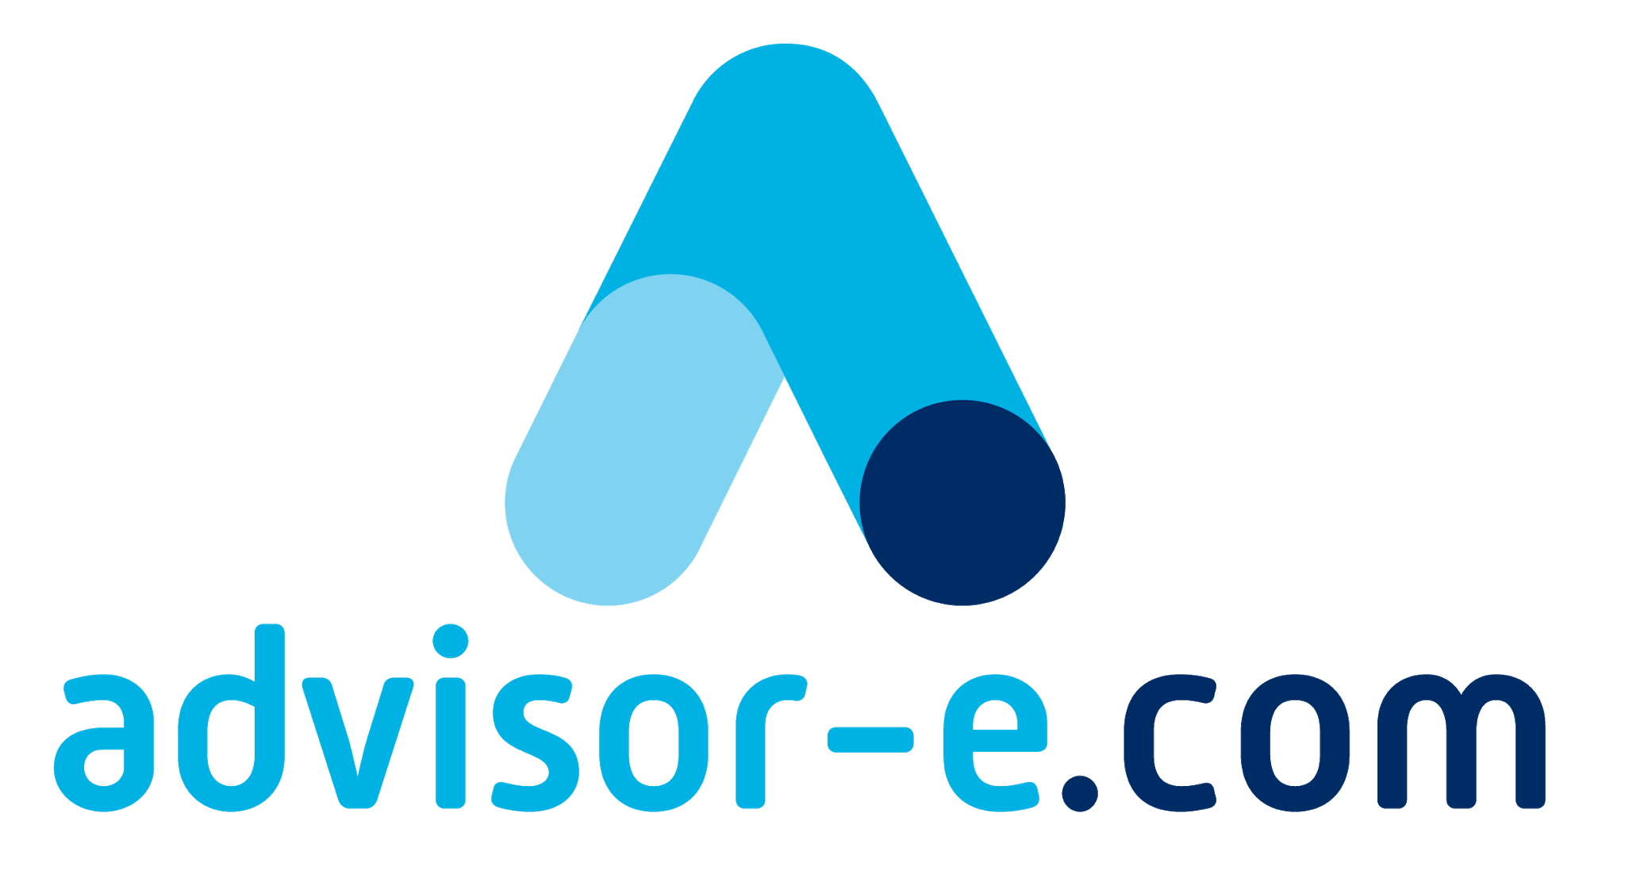
Your Sales Process Decision Tree
The thinking behind your approach & delivery...

Slide 2
Just So We’re Clear...
Campaign Selling vs. Total Needs Selling
(Approaching clients with a pre-packaged solution to a common issue)
(Approaching clients with an explorative process, void of any solution bias)
Modular Delivery vs. Bespoke Delivery
(Pre-packaged solutions that have been tested and developed over time)
(‘Starting from Scratch’ with each delivery solution)

Slide 3
Decisions, decisions...
The DESIGN of your sales process {HOW you sell it} does not (necessarily) dictate your solution. {WHAT you sell}
Campaign Sales Process
Total Needs Sales Process
Pro’s | Con’s
Reduces confusion for the salesperson and the client. Easier to determine logistics which makes the management of multiple sales people easier. Less time involved which makes it better suited to lower value sale items and easier to ‘pick up and put down’ when you’re busy with client work. | Potential to miss aspects that could contribute to a better outcome for your client. Each time you re-visit the client, it (can) look like you’re trying to upsell the client in order to fix issues you should have spotted in the first place. The ‘in and out’ nature can come across as pushy if you don’t pay attention to your tone, posture and the use of models & sliding questions.
Pro’s | Con’s
You can ‘sell once, then deliver for the next 3 years’. Everybody has a better understanding of the inter-relatedness of your services and objectives, which provides a more predictable outcome. Your ‘Global’ view of the client’s needs lets you better plan your workflow. | More confidence and experience required as you’re (generally) offering solutions to more complex problems. Timeline is more extended which requires greater discipline and monitoring of the sales activities. The ‘wins’ are larger but then again, so are the ‘losses’ when you invest a load of time and prove unsuccessful (which of course, is going to happen from time to time)
Aimed at smaller, less complex business circumstances. The sales process generally involves 1-2 meetings, takes 1-2 hours to complete and is seeking work in the $6 - $12k fee range.
Aimed at larger, more complex business circumstances. The sales process generally involves 3-5 meetings, takes upwards of 10 hours to complete and is seeking work in the $30k+ fee range.

Slide 4
Decisions, decisions...
The DESIGN of your advisory solution {WHAT you recommend} does not (necessarily) dictate its effectiveness. {HOW it helps your client}
Modular Service Delivery
Bespoke Service Delivery
Pro’s | Con’s
Reduces confusion for the advisor and the client. Easier to determine logistics which makes the management of multiple clients easier. Less time involved in preparation which makes it easier to deliver; (especially when busy with compliance work) and improves the financial recovery of the engagement. | Potential to miss aspects that could contribute to a better outcome for your client. Some of the delivery components (Modules) may require an understanding of, or have a reliance on, another module. If your client has not engaged you to complete (that) module then your delivery may be effected.
Pro’s | Con’s
You can be assured that your solution is not being compared to other providers at a ‘commodity level’. Your competency and experience is better recognised which increases your ability to charge on a ‘value based or success fee’ style basis. | More confidence and experience required as you’re (generally) offering solutions to more complex problems. Greater time is required in preparation which may result in lost fee recovery. You’re in effect, ‘Testing as you go’ with the project; this increases the risk of making mistakes that could affect both you and your client.
Designed to increase the capacity of you and your team to deliver advisory services to the marketplace; this provides various (client) price point options and reduces training time.
Required for more complex business circumstances where the modification of an existing module is not possible or financially viable.

Slide 5
Where to Start as a NEW Advisor?
Start with the ‘Free Client Content’ section and engagement process.
Why?
Because it gives you AND THE CLIENT a ‘softer’ experience. The biggest difference between the T.C.M (Time, Control, Money) / free client content process and the Lite Fundamentals process is that the T.C.M process DOES NOT end with a specific offer.
This removes any feeling of being ‘channelled’ (for both parties) and ‘sets the scene’ for another meeting to discuss needs/wants and service offers AFTER the client REFLECTS ON THEIR RECENT EXPERIENCE.

Slide 6
(Confident & Experienced Advisor) Approach & Sales Process Decision Tree
Existing Client
Targeted Prospect
Referral Received or ‘Walk-In’
Are you confident enough to start the process in a more consultative manner? (Less scripted/ structure but you must ‘think on your feet’ to scope and draw to conclusion)
Client has done project or advisory work with you before
First meeting reveals client ‘sophistication’
Client has specific issue or interest in service offer
YES
NO
YES
NO
NO
YES
YES
NO
Client fits small business profile; you suspect fee resistance; client also lacks fundamental knowledge of basic $ management principles
Solve this client issue but position wider to Loop other service offers in future
Approach for Education based session
Client fits ‘larger business’ profile
Client fits ‘smaller business’ profile
Client enjoyed education session & wants more
YES
NO
NO
YES
Client fits ‘smaller business’ profile
Is the client smaller in size; growth focused but has only used you for compliance work or basic forecasting or tax issues
YES
NO
YES
Still use Lite Fundamentals sales process but modify your offer to include shorter or longer session times for certain content
NO
‘Park’ process until client project pushes the need
YES
NO
YES
Approach & Engage via the ‘Planning Outcomes Review’ Doc & select appropriate planning session as a means to scope and upsell
Approach & Engage using the Lite Fundamentals (Campaign) sales process
Approach & Engage using the Total Needs sales process

Slide 7
Prepare Your (Campaign) Approach
Approach Method | Relationship Status | Steps to Discovery/ Alignment Meeting | Discovery/ Alignment Meeting Style
Direct Approach – Phone Call | Warm & Receptive, Open to New Ideas (Easily pass the “How was your weekend?” test) | 1 | Growth Curve EOY/ Volatility Review Revenue Model How you rate tables Strategic Planning Template
Pre-Approach EMail (Quiz/ Video Link) then Phone Call | Warm but Wary, still guarded around arena | 3 (1. Phone to ask for permission to send quiz or video link. 2. ‘Prime’ the client via online quiz or video. 3. Phone to ask for the meeting) | Growth Curve EOY/ Volatility Review Revenue Model How you rate tables
Pre-Approach EMail sequence (depth charges?) then Phone Call, then ‘intro’ meeting before actual discovery meeting. | Cool but engages, perhaps multiple decision makers? Need to ‘see before they move’. | 3 (1. Educating about the need, via multiple email or webinar. 2. Position the meeting during phone call, 3. Run a ‘taster’ meeting before ‘Deep Dive’ Discovery/ Alignment meeting) | Growth Curve EOY/ Volatility Review Revenue Model
Group Positioning – Seminar to introduce concept | (Group) Cool to new ideas, need time to reflect | 2 (1. Invite to seminar, conduct the event & then follow-up to invite to a 2. ‘personal discovery session’) | Growth Curve EOY/ Volatility Review Revenue Model How you rate tables

Slide 8
The (Honey & Mumford) 4 Processing Styles
1. Activist
Impulsive, Quick to decide: “I like it, I want it now”. They interested in sequence of ACTION - explain the ‘steps to purchase’.
2. Pragmatist
Emotive but want reassurance; they seek PROOF - provide data, testimonials, statistics, case study examples etc.
3. Reflector
They need TIME; making decisions disturb them emotionally so they need to withdraw and work through the process.
4. Theorist
They need to CONTRIBUTE; allow them to voice their thoughts and ideas on the solution and the purchase/ delivery/ installation process. Explain the areas that are ‘not open to variance’ but invite them to ‘help get the best outcome for everyone’.
The ‘trick’ is not to attempt to guess the person’s dominant processing style but rather, to DESIGN a sales process that considers the processing / decision needs of the customer and make the process ALLOW for each style - every time.
This makes life far easier for both the salesperson AND the customer as predictable tensions can be avoided, and ‘buyers remorse’ significantly reduced, simply by letting people decide in a manner that suits them.

Slide 9
The Logical (Campaign) Decision Points
1
Positioning
Do they fit my profile, Are they approachable?
2
Does the prospect have a legitimate need/want for my product or service, Will it be a profitable & enjoyable engagement for me?
Needs / Wants
3
Does the prospect have the Financial & Non-Financial Means to be able to complete a transaction with me? (Time, Money, Health, Age, etc.)
Qualification
4
Does my product or service offer satisfy their needs & wants; Is it a win-win, Is there anything I’ve missed that could prevent us doing business?
Presentation
Elimination
What can I ‘take off the table’ to narrow the focus of decision, will the prospect allow me to engage in their ‘decision space’?
5
Is the answer yes/no or a reduction or layered delivery over time, If so why/why not and How long, Is their request acceptable to me/business?
6
Win - Win

Slide 10
The Logical (Total Needs) Decision Points
1
Research
Is the customer willing to engage with me, is the decision maker present?
2
Phone Call
Will they agree to meet, Are they open minded?
3
Introduction
Is there a need for further discussion, What are the chances of doing business now or in the future, Who else needs to make the decision?
4
Scope
Does the prospect have a legitimate need/want for my product or service, what are the complexities/drivers of the engagement and will it be a profitable & enjoyable engagement for me?
5
Presentation
Does my product or service offer satisfy their expectations, needs & wants, Is it a win-win, Is there anything I’ve missed that could prevent us doing business?
6
Implementation
Is the answer yes/no or a reduction or layered delivery over time, If so why/why not and How long, Is their request acceptable to me/business?

Slide 11
5 CRITICAL Sales Process Reminders
The transition from ‘Selling’ to ‘Consulting’ should be seamless; think of your entire process as ‘Serving’.
‘Serving’ requires an open mind and open heart; remove judgement from the equation. If you’re focused on the outcomes for yourself or your firm, rather than the genuine opportunity for your client, then you’re more likely to allow judgement (of yourself and of the client) to erode your authentic dealings.
‘Perspective’ is critical to build confidence for both parties. Perspective requires a collaboration of views WHICH IS WHY it’s so important to include a scenario model (what if google sheet) as early as you can in the sales process. The model establishes clarity and increases client belief (at the same time – it allows you to qualify the legitimate opportunity)
SLIDING SCALE questions (“how do you rate yourself on a 1-5...”) reduces judgement BECAUSE it introduces context into the assessment; this allows people to access their ‘problem solving’ brain function and (provided your tone and body posture is congruent with your client) settles your client’s amygdala and therein, their ‘fight or flight’ response.
Don’t make the process ‘too easy’ for the client; in order to get their ATTENTION – you need a bit of TENSION. This means, they have to be confronted with the ‘gap’ between their current position and their desired position; THEY ALSO HAVE TO have made a series of micro-decisions in your favour which is why the “Could you live with these 3 requirements” script is so important. (covered in the Lite Sales Track )

Slide 12
Your ‘Behind the Scenes’ Toolbox Suitability
To a man with just a hammer, everything looks like a nail...
Stage | Fundamentals that must be evident to support business Growth
Exit Decline | Able to demonstrate strong, repeatable profits that are not reliant on direct input from business owners. Practised in ‘getting out of the way’ and allowing key staff to make decisions and correct mistakes. Cognisant of market ‘timing cycles’ and financially able to wait if required for optimal sale. Well versed in ‘translating wishes to action plans’... What you’re left with if you’ve failed to learn and practice the business fundamentals...
Leapfrog & Maturity | Solid understanding of Leadership tactics & Basic Personality Types. Sound knowledge of underlying industry profit drivers (scenario analysis), strong benchmark data awareness and reasonable knowledge of valuation ‘variables’ and Modern Systems Theory. Experienced in ‘putting Ego aside’ when receiving advice from professional advisers within a Governance framework (advisory or board structure). Experienced in ‘business dating’ concept, Jo-Hari Window and in achieving formal structure (expectations) with sub-contractors and/or C.O.I’s.
Leverage & Reach | Solid understanding of process improvement (without ‘dumbing down’ the employees), Formal Risk Management & Governance ethos is dominant, strong recognition of what drives employees, sound delegation/review techniques combined with well practised ‘problem solving’ and communication/meeting tools (such as De Bono’s 6 hats). Willingness to explore employee diversification & challenge std hierarchy's. Clear understanding of Revenue Streams and financial value to client reflected in pricing and client retention. Knowledge bank is seen as a priority.
Lifestyle | Relevant Sales Process for Industry. (Point of sale, Consultancy or Territory Style) Combined with a Marketing Plan that caters to customer profile, message, medium, frequency, budget. Understanding of Marketing Fundamentals (Progression of Value & Technology Opportunity Points) Financial understanding of Volatility and Liquidation values, KPI’s (lead & Lag), Debt/Tax structure. Well versed in conducting S.W.O.T & P.E.S.T reviews resulting in Well Defined Operational Objectives, Understanding of the business Value Chain (incorporating Vertical & Horizontal Integration)
Design to Break-even | The 8 Profit Levers – Mthly Break even point and Lifestyle targets (Capacity Model) - Working Capital Cycle (Developing Cash flow forecasts) and Fixed Capital Needs (Developing Expense Budgets) - ROI (investment) and ROA (assets) Mentality - Market Diffusion Theory, Product Life-cycle - The Effects of Discounting – Organising your P&L Categories for Management vs. Job Costing Reports – The 3 Business Divisions (Get Organised, Get the Job, Do the Job) & 6 Business Focus Areas as Systems (Planning, $ & Data Management, Marketing, Sales, People, Process)

Slide 13
Flowcharting Your Sales Process

